Slide 1
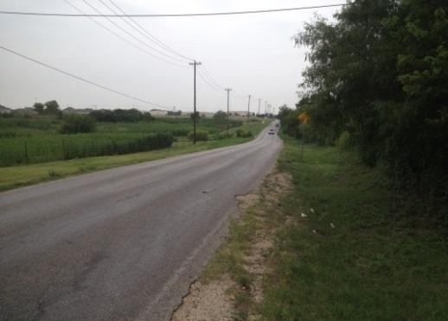
LEHMAN ROAD RECONSTRUCTION
CITY COUNCIL
PROJECT STATUS UPDATE
OCTOBER 8, 2014

Slide 2
01
Proposed Typical Sections
02
Right of Way and Utility Impacts
03
Budget and Cost Estimate Update
04
Schedule of Activities

Slide 3
01
Proposed Typical Sections

Slide 4
PROPOSED TYPICAL SECTIONS
Functional Classification: Minor Collector
ADT (2014): 4114 VPD (2034): 7430 VPD 4.6% Heavy Vehicles
Existing Lehman Road Typical Section
Alternate 1 – Proposed Typical Section
As presented during bond election.
Four Lane sections on either end of project with a narrower 3 lane section through the subdivisions.

Slide 5
PROPOSED TYPICAL SECTIONSALTERNATE 1 (CON’T)
PRAIRIE ON THE CREEK
CONC BOX CULVERTS
LAKE KYLE PARK
FOUR SEASONS FARMS

Slide 6
PROPOSED TYPICAL SECTIONSALTERNATE 1 (CON’T)
PRAIRIE ON THE CREEK
STEEPLECHASE
BRIDGE
FOUR SEASONS FARMS

Slide 7
PROPOSED TYPICAL SECTIONS ALTERNATE 1 (CON’T)
STEEPLECHASE
Three lane section maintained to just south of intersection with Goforth Road. A fourth lane added to provide for dedicated left and right turn lanes at the intersection
Signal warrant study being preformed for the Lehman Road / Goforth intersection
Corner clip of parcel in southwest corner of intersection to provide improved sight distance
LEHMAN HIGH SCHOOL

Slide 8
PROPOSED TYPICAL SECTIONS
Existing Lehman Road Typical Section
Alternate 2 – Proposed Typical Section
Maintain functionality
Maintain 3 lane section throughout
Dedicated left and right turn lanes at FM 150

Slide 9
PROPOSED TYPICAL SECTIONSALTERNATE 2 (CON’T)
Maintain functionality
Maintain 3 lane section throughout
Narrower non-multiuse travel lanes

Slide 10
PROPOSED TYPICAL SECTIONS ALTERNATE 2 (CON’T)
Three lane section maintained to just south of intersection with Goforth Road. A fourth lane added to provide for dedicated left and right turn lanes at the intersection
Same as Alternate 1 but with 11’ lanes.
Signal warrant study being preformed for the Lehman Road / Goforth intersection
Corner clip of parcel in southwest corner of intersection to provide improved sight distance
LEHMAN HIGH SCHOOL

Slide 11
PROPOSED TYPICAL SECTIONSALTERNATE 2A
Minimize section in areas within floodplain that are not reasonably developable.
Tributary to Plum Creek (Stream Plum-1) & Plum Creek.
Estimated $600,000 project savings.
End 2-Ln Section
Begin 3-Ln Section
End 3-Ln Section
Begin 2-Ln Section
2-Ln Bridge
3 Lane section
2 Lane Section
End 3-Ln Section
Begin 2-Ln Section
End 2-Ln Section
Begin 3-Ln Section
2-Ln Bridge

Slide 12
PROPOSED TYPICAL SECTIONS
Existing Lehman Road Typical Section
Alternate 3 – Proposed Typical Section
Maintain functionality
Minimize pavement by utilizing 2 lane section to maximum extent
2 lane bridge over stream Plum-1 (SCS Dam) & Plum Creek
Dedicated left and right turn lanes at FM 150 on south end of project.
3 Lane section
2 Lane Section

Slide 13
PROPOSED TYPICAL SECTIONSALTERNATE 3 (CON’T)
Dedicated left turn lanes at intersections only
Masonwood Drive, Primrose Blvd., Goldenrod St. and Hiver St.
MASONWOOD DR.
HALLIE DRIVE
3 Lane section
2 Lane Section
PRIMROSE BLVD
GOLDENROD ST
HIVER ST

Slide 14
PROPOSED TYPICAL SECTIONSALTERNATE 3 (CON’T)
GOFORTH RD
Dedicated left turn lanes at Brutus Drive
Dedicated left turn lane into Lehman HS
Dedicated left and right turn lanes onto Goforth Road
BRUTUS DR
LEHMAN HIGH SCHOOL
4 Lane section
3 Lane section
2 Lane Section

Slide 15
PROPOSED TYPICAL SECTIONSProposed Pavement Section
Geotechnical Engineer provided 4 options
Option 3 presented below:
18-yr design life
Periodic maintenance will be required
Crack seal (as necessary)
Periodic Overlay (6 – 8 yrs)
Proposed Pavement Section
4” of Type C HMAC
10” of Flexible Base Material
Geogrid (Ty II)
8” of Lime Stabilized Subgrade
Geotechnical Consultant finalizing investigation for sulfates in soils. If sulfates are found, double lime treatment or other chemical measures will be required to control impacts on pavement structure.

Slide 16
02
Right of Way and Utility Impacts

Slide 17
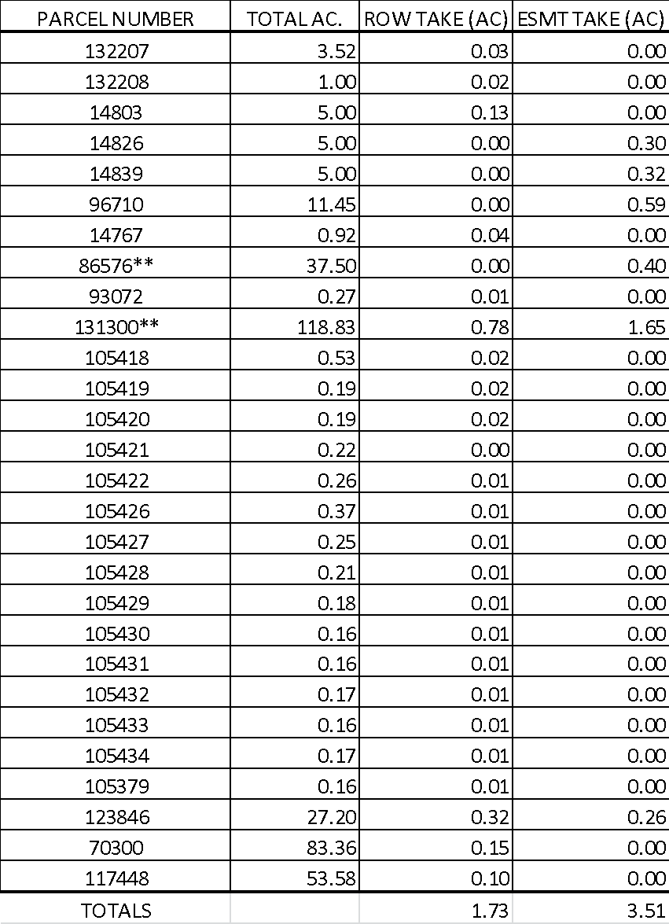
ROW IMPACTS
ALTERNATE 1
Total of 29 Parcels impacted
Small ROW take of 5’ required from back yards of about 15 homes in the Four Season Farms subdivision.
Total ROW Acquisition ~ 1.73 Acres (23 Parcels)
Easements are slope easements. Property is retained by owner, but use and future development is limited by the slope easement.
Approximately 60’ each side @ Stream Plum-1 (Lake Kyle Park)
Approximately 30’ each side @ Plum Creek crossing
Total Slope Easement Required ~ 3.51 Acres (6 Parcels)
** City of Kyle Property

Slide 18
ROW IMPACTS
ALTERNATE 2
Total of 13 parcels impacted
NO ROW take required from back yards of homes in the Four Seasons Farms subdivision.
Total ROW Acquisition ~ 1.03 Acres (6 Parcels)
Easements are slope easements. Property is retained by owner, but use and future development is limited by the slope easement.
Approximately 60’ each side @ Stream Plum-1 (Lake Kyle Park)
Approximately 30’ each side @ Plum Creek crossing
Total Slope Easement Required ~ 3.69 Acres (7 Parcels)
Slope easement acreage slightly decreased for Alternate 2 +2A. Decrease from 3.69 acres to 2.75 acres.
Approximately 45’ each side @ Stream Plum-1 (Lake Kyle Park)
Approximately 15’ each side @ Plum Creek crossing
** City of Kyle Property

Slide 19
ROW IMPACTS
ALTERNATE 3
Total of 13 parcels impacted
NO ROW take required from back yards of homes in the Prairie on the Creek subdivision.
Total ROW Acquisition ~ 0.91 Acres (6 Parcels)
Easements are slope easements. Property is retained by owner, but use and future development is limited by the slope easement.
Approximately 45’ each side @ Stream Plum-1 (Lake Kyle Park)
Approximately 15’ each side @ Plum Creek crossing
Total Slope Easement Required ~ 2.75 Acres (7 Parcels)
** City of Kyle Property

Slide 20
UTILITY IMPACTS
ALTERNATE 1 – HIGH IMPACT
Approximately 1,940 LF of Water Line
Approximately 2,130 LF of Wastewater Line
Approximately 8,135 LF of Gas Line
Approximately 900 LF of Overhead Electric Line
Approximately 720 LF of Telephone / Fiber Optic Line
ALTERNATE 2 & 2A – MODERATE IMPACT
Approximately 1,940 LF of Water Line
Approximately 2,130 LF of Wastewater Line
Approximately 8,135 LF of Gas Line
Approximately 900 LF of Overhead Electric Line
Approximately 720 LF of Telephone / Fiber Optic Line
ALTERNATE 3 – LOW IMPACT
Approximately 840 LF of Water Line
Approximately 2,130 LF of Wastewater Line
Approximately 640 LF of Gas Line
Approximately 900 LF of Overhead Electric Line
Approximately 240 LF of Telephone / Fiber Optic Line

Slide 21
03
Budget and Cost Estimate Update

Slide 22
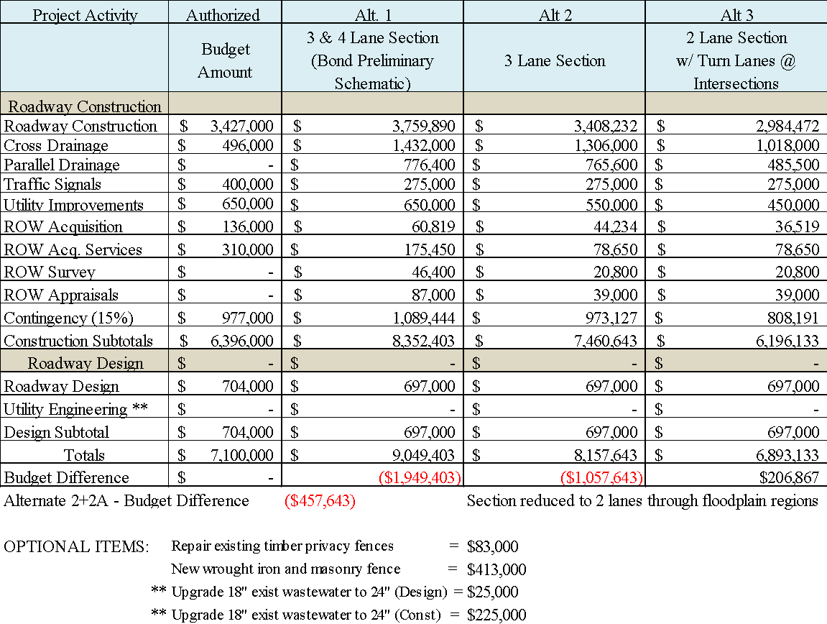
PROJECT COST ESTIMATE UPDATE

Slide 23
04
Schedule of Activities

Slide 24
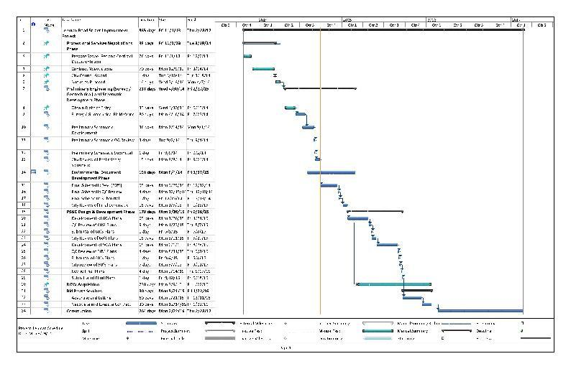
SCHEDULE OF ACTIVITIES
Final Schematic – Dec 2014
ROW Acquisition – Jan 2016
Final Plans – Sept 2015
Let for Construction – Dec 2015
Begin Construction – Feb 2016
ROW Acquisition. Fewer parcels will reduce time requirement. Schedule will need to be extended about 4 months if ROW services not performed through a supplement to the base contract.

Slide 25
QUESTIONS?

