Slide 1

Goforth Road – Status Update
Typical Sections & Pavement Design
Budget & Preliminary Cost Estimate
Schedule
Extension from Bunton Creek Rd. to Kyle Pkwy.
Notes:
Good evening.
My name is Bob Austin. I am the Project Manager for the Goforth Road Project.
As requested, I am here to provide a status update on the Goforth Road Project and to answer any questions you may have.
Additionally, I have prepared budget information on a possible extension to the north of Goforth for your consideration.

Slide 2
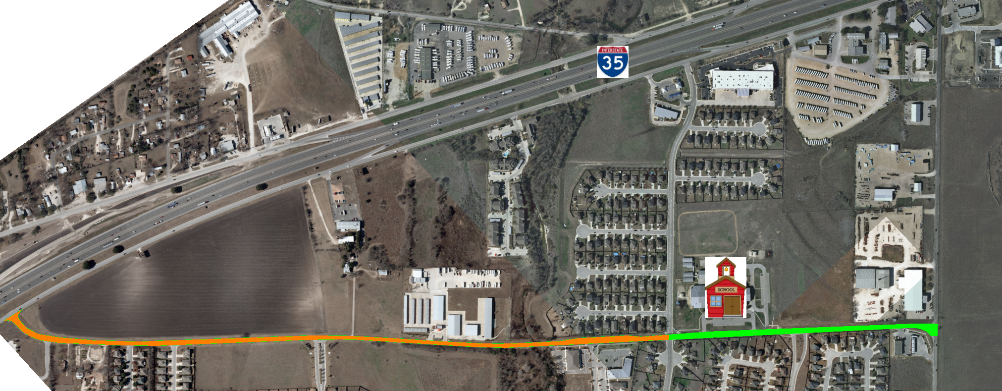

Project Overview Map
Brent Boulevard
Bunton Road
Goforth Road
Susie Fuentes Elementary School
Notes:
The project begins at the IH 35 east frontage road and extends 1.20 miles to Bunton Road at the north end.
From IH 35 to Brent Boulevard (as shown in orange), the proposed roadway will be a 3-lane section including one lane in each direction with a center two-way left turn lane. This was proposed in the Bond Program and is what the Traffic Study indicated was needed as well.
We have worked hard to fit within the existing ROW; however, even so we will need slivers of ROW as shown. These portions of needed ROW are __’ wide on average.
We are not acquiring any residential ROW.
All proposed ROW acquisition is either on undeveloped property or property with no improvements located on the piece we need to acquire.

Slide 3
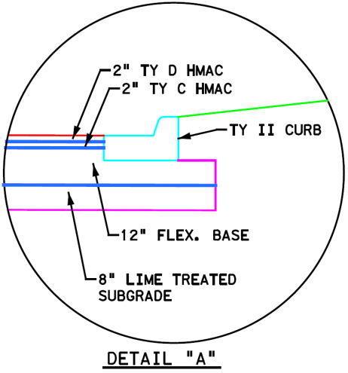
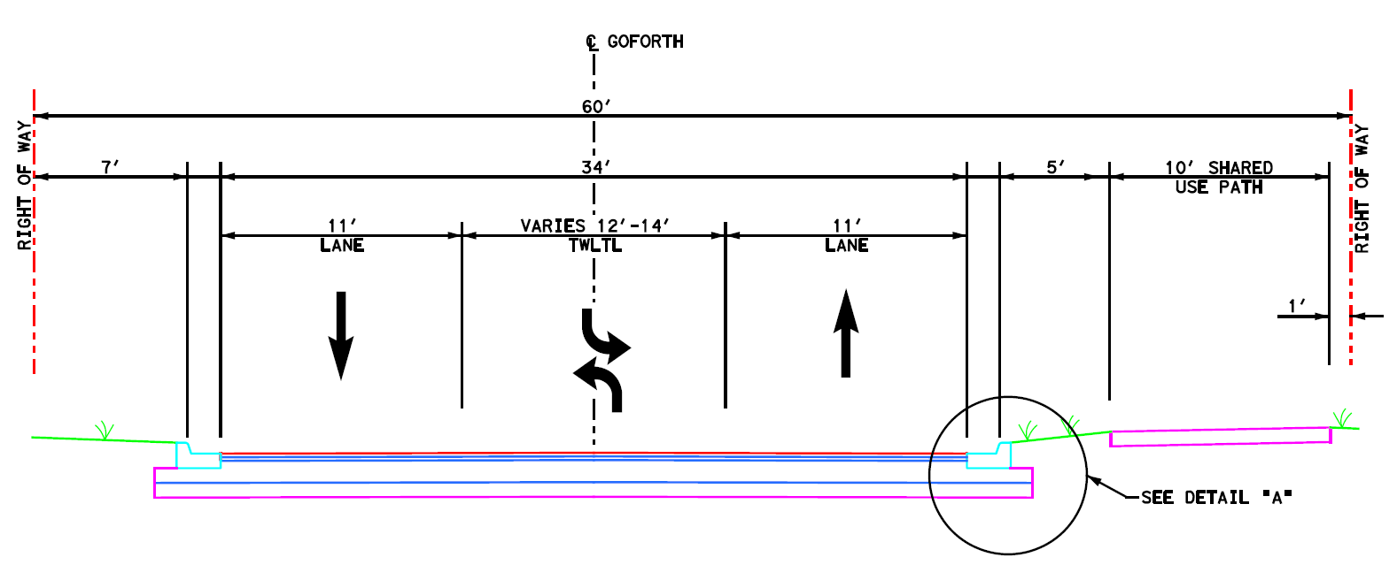
Proposed Typical Section
IH 35 to Brent Blvd.
Notes:
This typical section shows the three-lanes, a shared use path and the pavement design and has several benefits such as:
+ By using a shared use path that is separated by 5’ away from the travel lanes, it increases safety for the pedestrians and bicycles – especially for the elementary school children that use it to go to Susie Fuentes Elementary
+ We have decreased the lane widths from 12’ to 11’ which slows the traffic slightly and it saves funding.
+ We are using a storm sewer system rather than a ditch system to keep the ROW widths narrow which is less expensive ROW for ditch sections.
The pavement design for this area is
8” LTS
12” Flex Base
2” Ty C Hot-Mix &
2” Ty D Hot-mix.

Slide 4
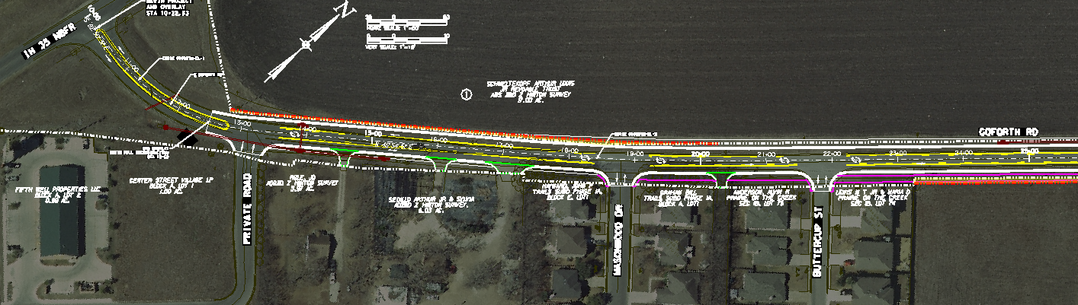
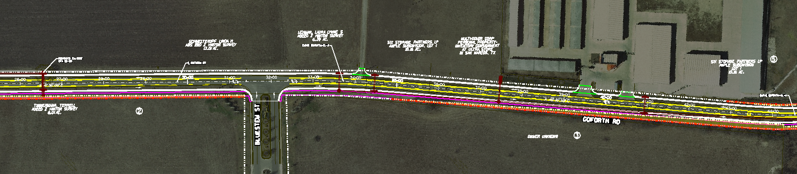
Right of Way Acquisition Map
ROW Acquisition
ROW Acquisition
ROW Acquisition
Notes:
We have worked hard to fit within the existing ROW; however, even so we will need slivers of ROW as shown. These portions of needed ROW are __’ wide on average.
We are not acquiring any residential ROW.
All proposed ROW acquisition is either on undeveloped property or property with no improvements located on the piece we need to acquire.

Slide 5
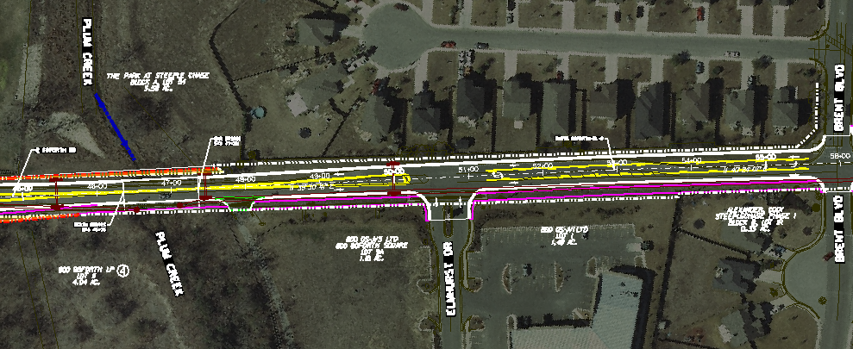
Right of Way Acquisition Map
ROW Acquisition
ROW Acquisition

Slide 6
Project Overview Map
Brent Boulevard
Bunton Road
Goforth Road
Susie Fuentes Elementary School
Notes:
The proposed roadway rom Brent Boulevard to Bunton Road (as shown in green), will be a 4-lane section. This was proposed in the Bond Program and is what the Traffic Study indicated was needed as well. This will handle the increasing traffic volumes and the school traffic that queues up each morning and afternoon.

Slide 7
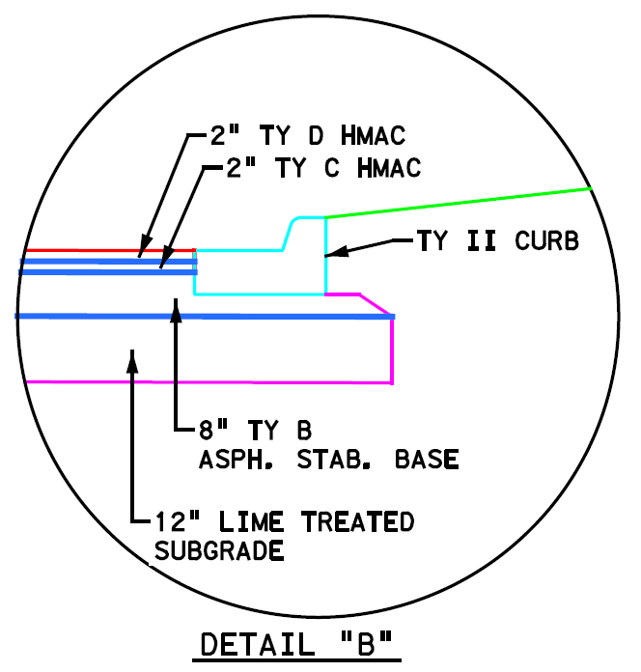
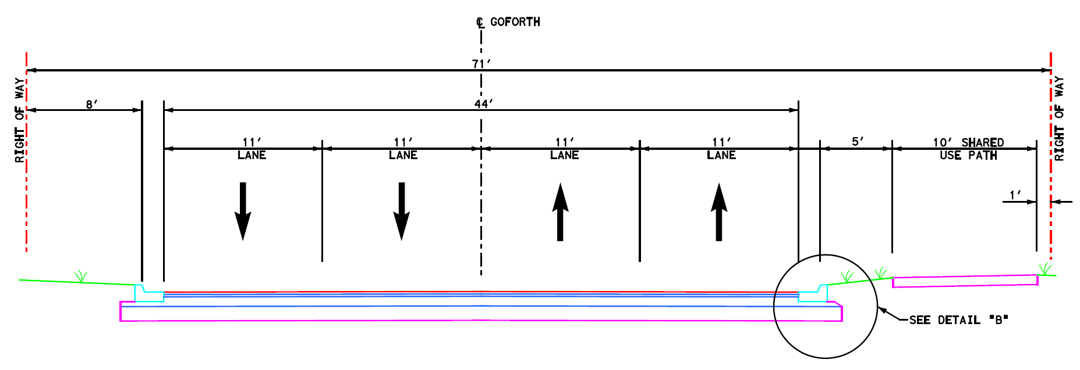
Proposed Typical Section
Brent Blvd. to Bunton Road
Goforth Road – Status Update
Notes:
This typical section shows the four 11’ lanes, continues the shared use path and shows the pavement design. So if the southbound traffic (which would be in the lane shown on the left) queues up at Susie Fuentes Elementary, we have another lane for through traffic to use.
This typical section also incorporates inlets and a storm sewer system.
The pavement design for this area is
12” LTS
8” Asphalt Treated Base
2” Ty C Hot-Mix &
2” Ty D Hot-mix.

Slide 8
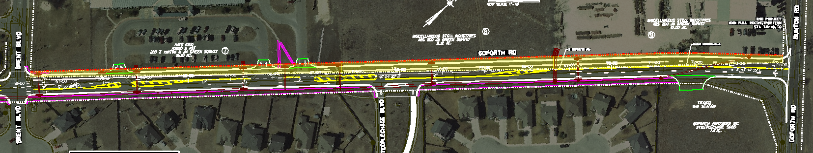
Right of Way Acquisition Map
ROW Acquisition
ROW Acquisition
Notes:
We have worked hard to fit within the existing ROW; however, even so we will need slivers of ROW as shown. These portions of needed ROW are __’ wide on average.
We are not acquiring any residential ROW.
All proposed ROW acquisition is either on undeveloped property or property with no improvements located on the piece we need to acquire.

Slide 9
Budget & Cost Estimate Update
Goforth Road – Status Update
Notes:
The Authorized Budget for Goforth Road is
$8.4 Mil. for Construction
$390,000 for ROW (Land Cost)
for a sub-total of $8,790,000.
The Prel. Engineering, Surveying, & Final Engineering budget is
$1,010,000
for a Total of $9.8 Mil.
We have prepared a construction cost estimate using our current schematic design and the estimate for it is
$6,176,804 for the construction of Goforth
$1,110,975 for Utility improvements and adjustments
$645,000 for ROW (Land Cost)
$108,900 for ROW Surveys, Appraisals & Acquisition Labor
$100,000 for a Contingency
for a Construction Sub-total of $8,141,679
The Prel. Engineering, Surveying, & Final Engineering costs based on the schematic is
$894,864.71
$106,404.55 for W & WW Engineering
for a Design Sub-Total of $1,001,269.26
and a Grand Total of $9,142,948.26.
Resulting in a budget difference of $657,051.74
Based on a cost per mile estimate, the Goforth Extension Construction will cost $1,066,241
$199,500 for the Preliminary & Final Engineering
for a total of $1,265,741 for the Goforth Extension (w/o ROW Land Cost)

Slide 10
Schedule of Activities
Goforth Road – Status Update
Notes:
We are on schedule as contracted.
We have completed the surveying, design cross sections, the Traffic Study, and the preliminary Schematic, Cost Estimate & Drainage Study.
We are set to have a Public Meeting in late October to gain public input into the project and to have a public hearing in late March.
We have a month of extra time built in to the schedule and can accommodate the Goforth Extension within this same timeframe if needed.
We are planning to set the construction phasing such that the construction in front of the school will begin and be substantially completed while school is out. The plum creek bridge would be constructed next summer also. Then the remaining portions of Goforth would be completed in the January 2016 timeframe.
Key to that happening is the Right of Way Acquisition. This needs to get going as soon as we have had our public meeting and our schematic has been approved. If we are authorized to do the ROW acquisition, we could begin as soon as we receive City of Kyle approval.

Slide 11
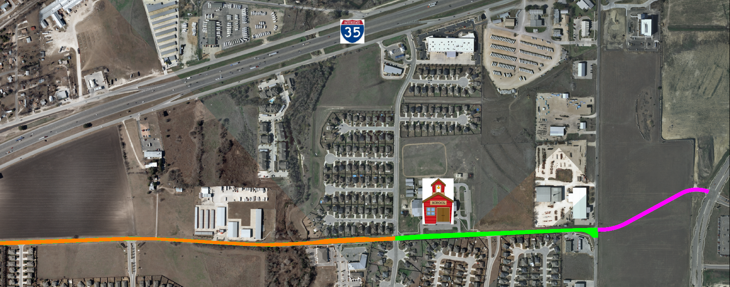
Proposed Extension
Goforth Extension
Goforth Road
Notes:
The portion in pink shows the possible extension of Goforth to the north from Bunton Road to Kyle Pkwy. The length of the Goforth extension would be 0.21 miles.

Slide 12
Thank You
Notes:
Thank You and at this time I would be happy to answer any questions you may have.

